Slide 1



DV HIGHER EDUCATION PERFORMANCE
DASHBOARD
BY:
JS DHAMINI SRUTHI

Slide 2
Project Overview
EduVision DV – Higher Education Intelligence System
The project focuses on analysing higher-education performance using university ranking and education datasets.
We worked with university, student, ranking, country and education indicators.
The objective is to convert raw data into meaningful visual insights using Tableau.

Slide 3
Milestone 1: Data Collection & Cleaning
What We Did
Downloaded the required datasets from the respective sources/Kaggle.
Checked University, Student, Country/Region and Ranking data.
Identified and removed duplicate records.
Handled missing values and incorrect/inconsistent data.
Corrected case-sensitive and naming inconsistencies.

Slide 4
Major Challenge:
The same country appeared with different names, such as USA / America, which created difficulty while grouping and comparing data.
Some numerical fields were stored in incorrect data types, such as decimal instead of integer, so they had to be corrected.

Slide 5
Milestone 2: Data Preparation & Analysis
What We Did
Prepared separate datasets for University Performance, Research and Student Analytics.
Combined relevant datasets using common identifiers.
Created KPI fields such as:
          Ranking scores
          International student percentage
          Faculty-to-student ratio
          Research indicators
        Validated the prepared data before using it in Tableau.

Slide 6
Milestone 3: DASHBOARD ANALYSIS
Student Analytics
Dashboard Analysis
International Student Analysis
Compares international student percentage across universities.
Faculty-to-Student Ratio
Compares ranking scores with faculty-to-student ratios.
Student Diversity Trends
Shows changes in international student participation across years and ranking sources.
Enrollment Comparisons
Uses World Bank tertiary enrollment data to compare countries over time.
Student Distribution
Compares international student participation across countries.

Slide 7
Country Comparison
Country-Level Analysis
Country Ranking Comparison
Compares countries based on average QS ranking scores.
This represents QS ranking performance, not overall national education quality.
Education Performance Benchmarking
Compares countries using enrollment, expenditure, graduates and literacy indicators.
Regional Education Trends
Shows long-term tertiary enrollment patterns across regional/income groups.
Top Performing Countries
Provides a geographical view of countries selected using QS ranking scores.

Slide 8
Tableau Dashboard & Integration
Interactive Tableau visualizations.
Filters for country, source and relevant indicators.
KPI cards for quick summary.
Navigation between different dashboards.
Charts such as bar charts, heat maps, line charts, scatter plots and maps.
Dashboard-level integration for comparing different dimensions.

Slide 9
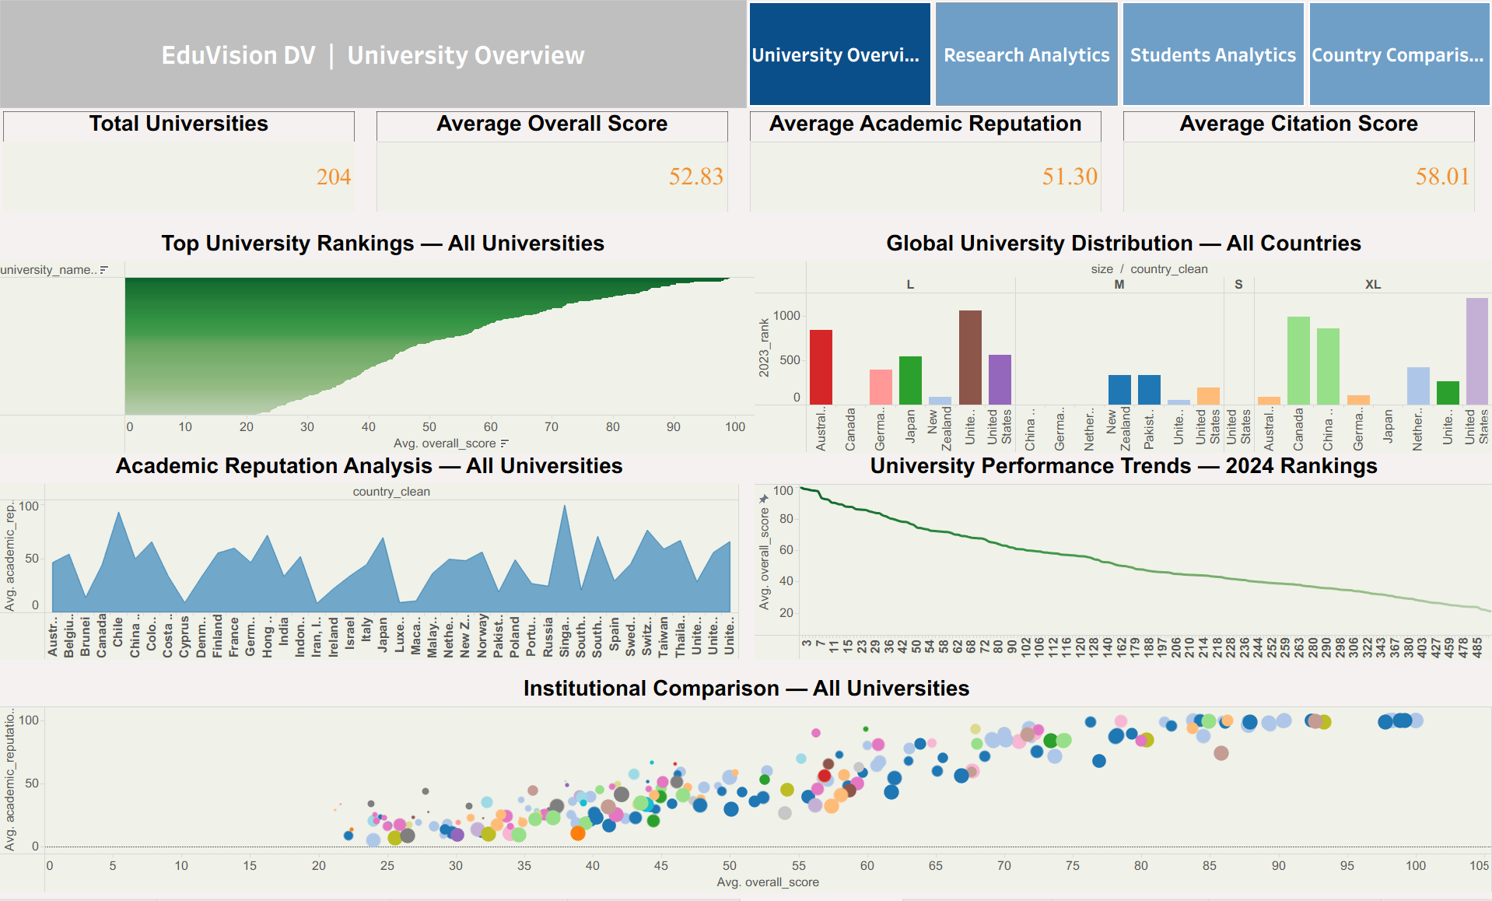
UNIVERSITY OVERVIEW

Slide 10
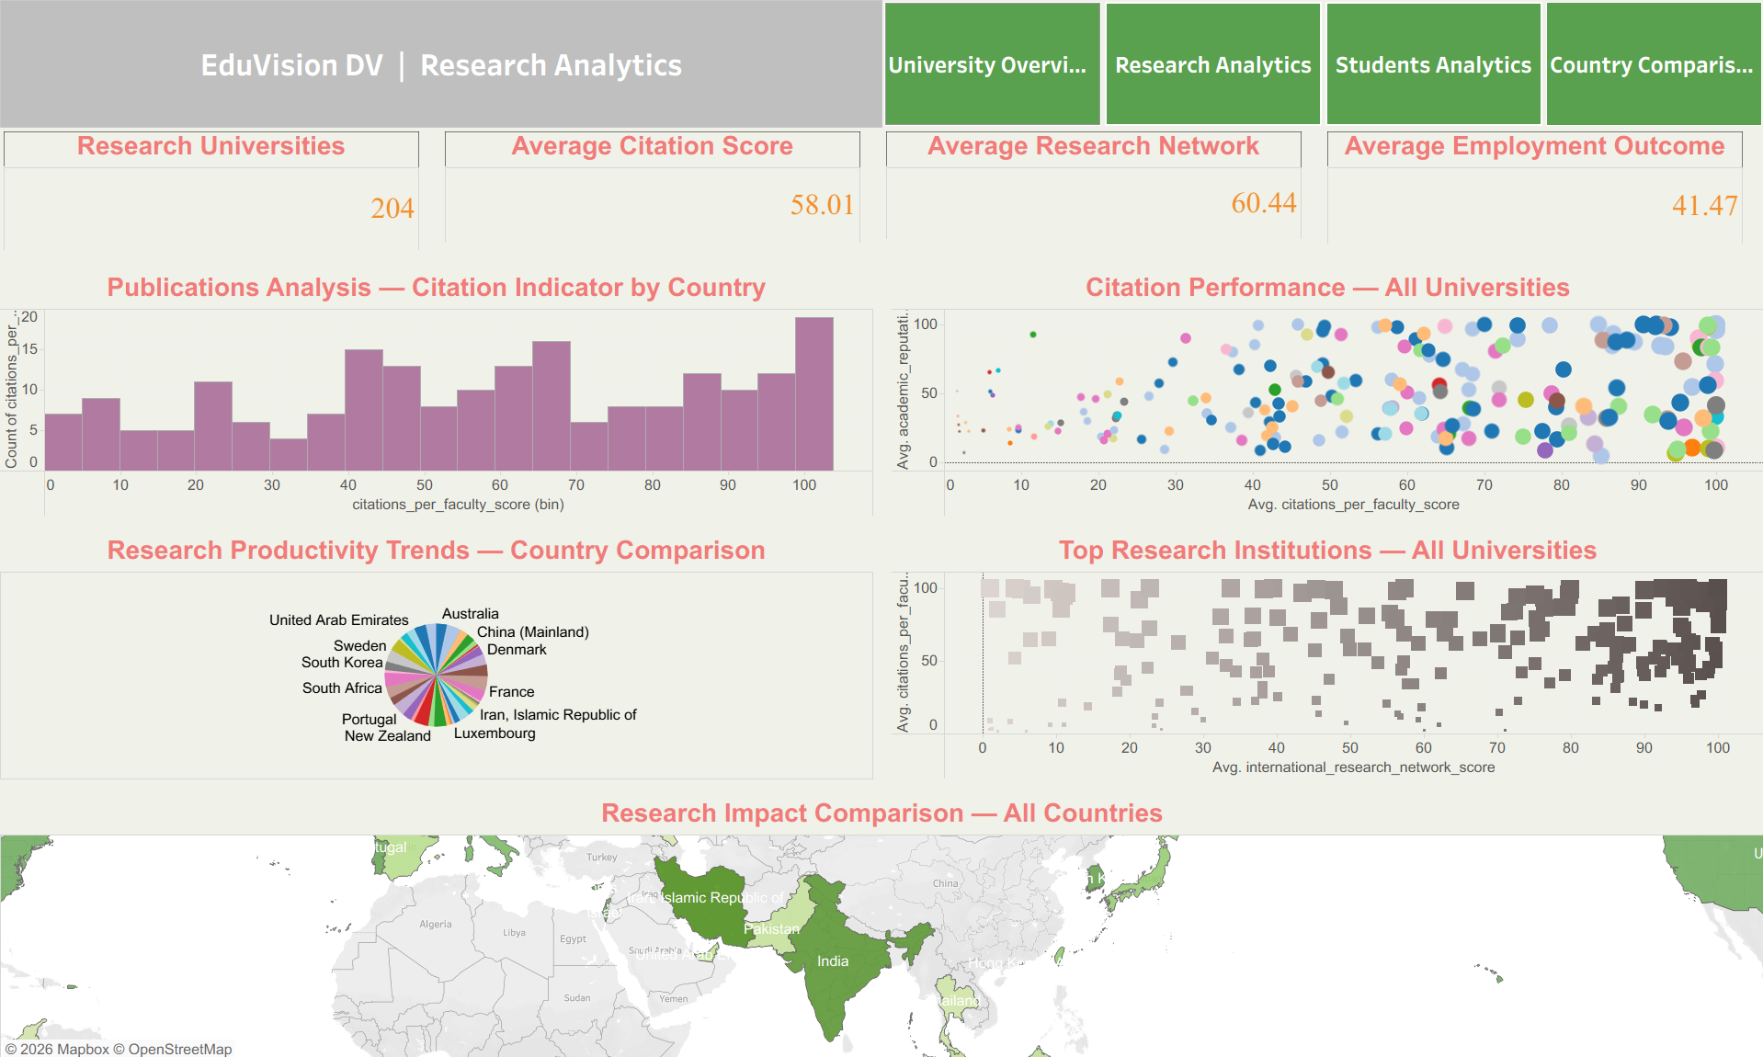
RESEARCH ANALYTICS

Slide 11
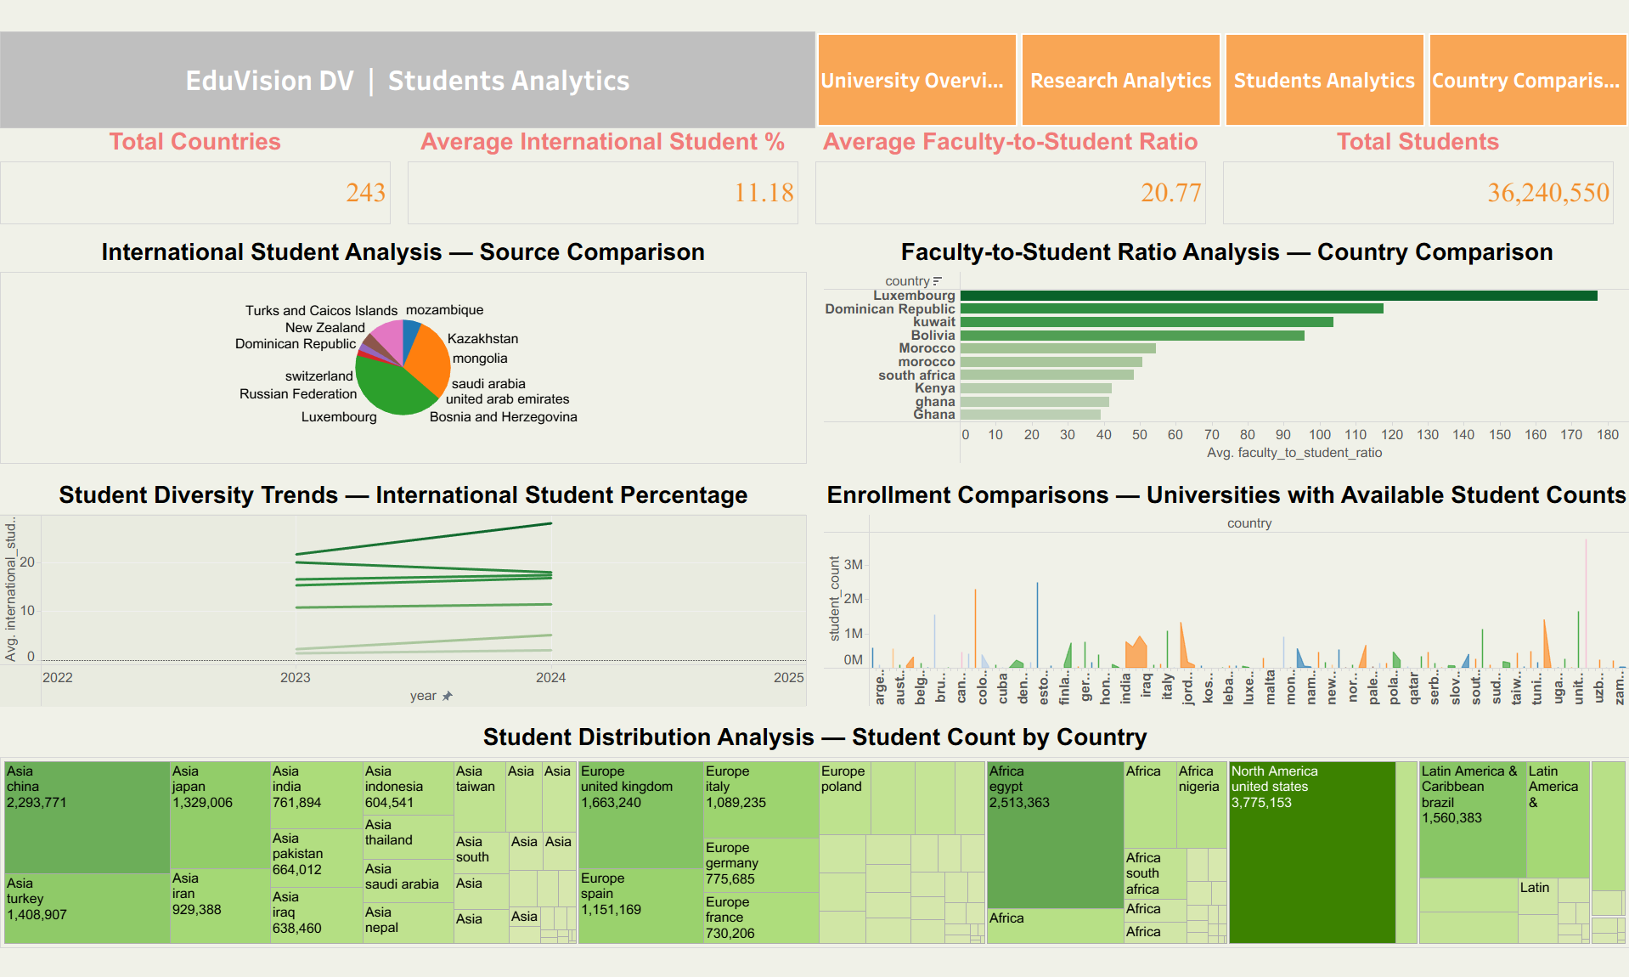
STUDENT ANALYTICS

Slide 12
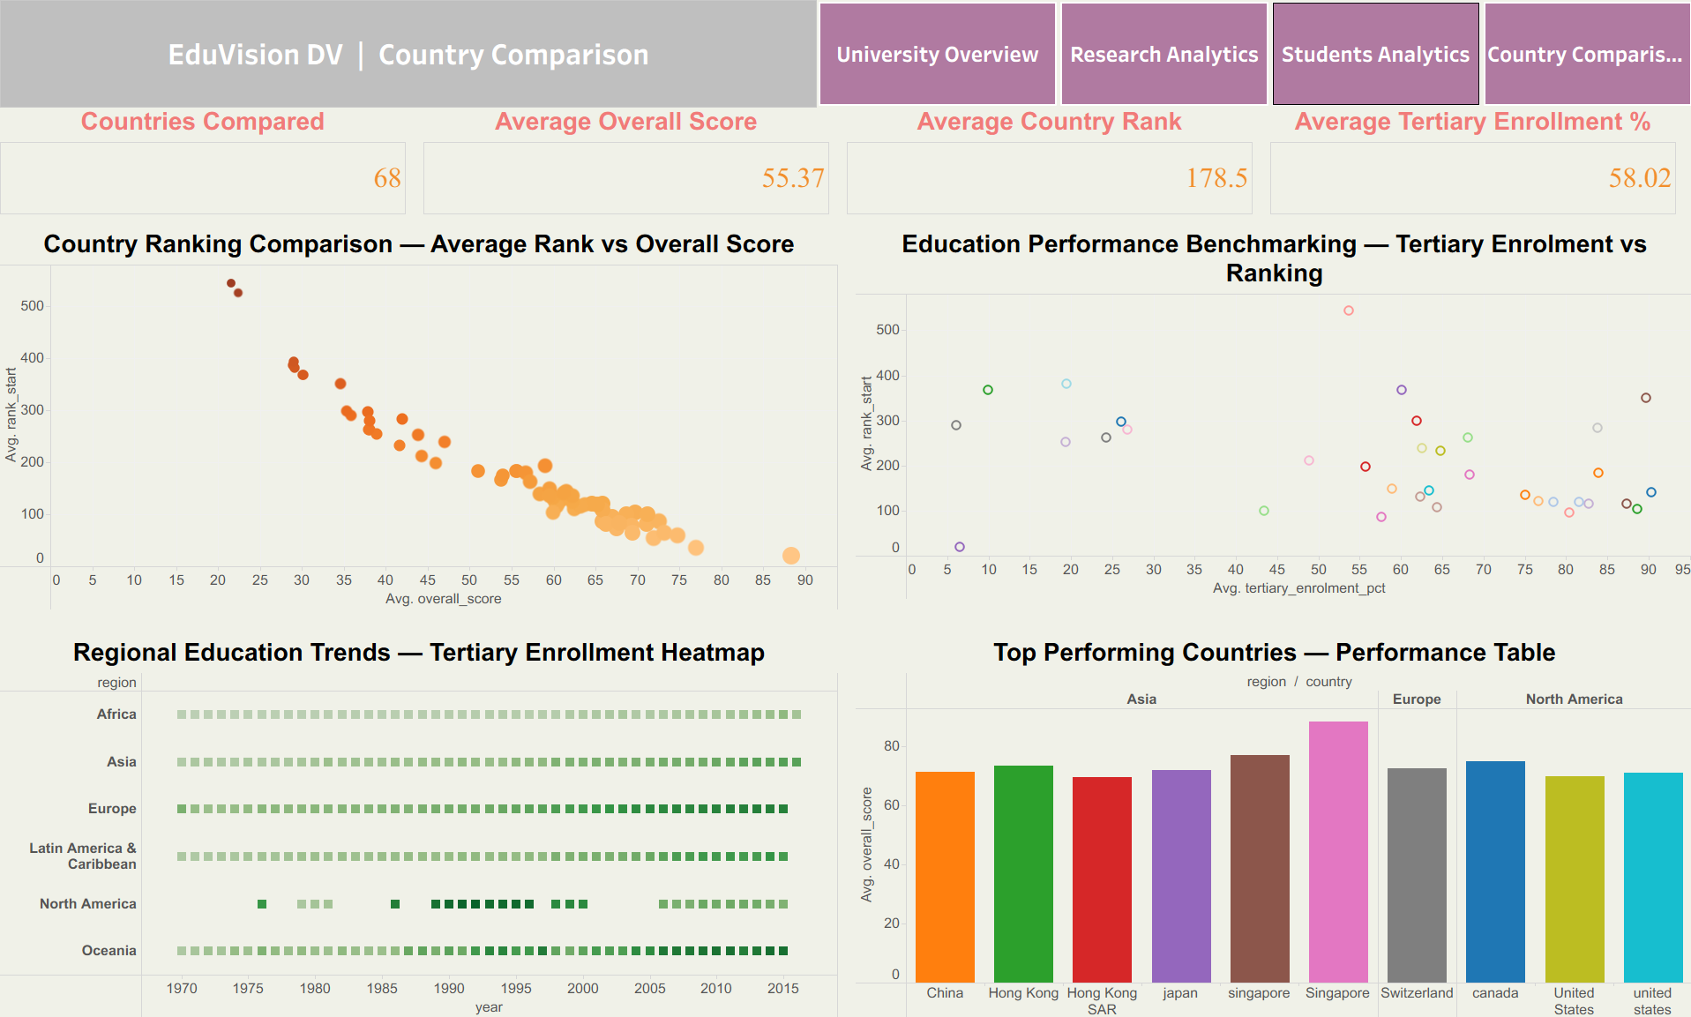
COUNTRY COMPARISON

Slide 13
THANK YOU!!

